Slide 1

Computer Programming Fundamentals
Coding Life
Presentation by:
D. PHIRI
LECTURER ICT DEPARTMENT

Slide 2


Course Outline
o1.
Introduction to Computer Programming
o2.
Programming Concepts
o3.
Programming Logic
o4.
Tools for Programmer
o5.
Trends in Software Development
o6.
Career Opportunities
o7.
How to succeed as a Programmer

Slide 3

Lesson Outline
Understanding Programming
What is it all about
Why Study it
Application areas

Slide 4

Code: Lets Understand it
We can not talk about Computer Program (Code) without knowing a computer.
Then, What is a computer?
Functions of a computer
What are Components of a computer
Code:
Unambiguous, ordered sequence of computational instructions that a computer executes necessary to achieve a solution.
Detailed plan or procedure for solving a problem with a computer
Simple instructions ( adding numbers, Displaying names, playing music)
Few lines of instructions are called (program)
If lines of codes are many may be in thousand or million lines of codes are called Software
Notes:
A computer is an electronic device that will take input from the user, process it, and give results or respond as per the user. The computer is a programmable computational device.

Slide 5


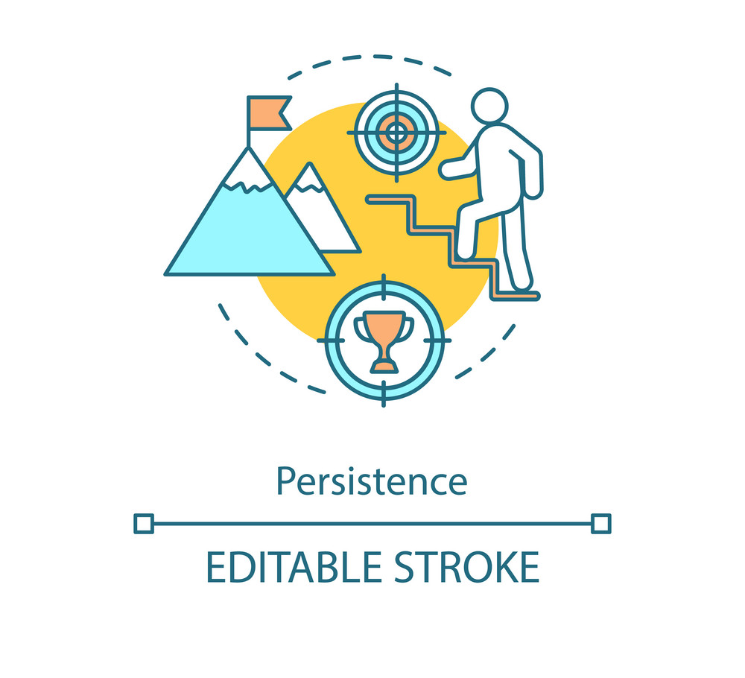
Code: Why study it
Problem solving
Creativity
Persistence
Coding Boosts Problem-Solving Skills
Coding Teaches Creativity and Computational thinking
Coding Encourages Persistence and determination

Slide 6



Code: Why study it
Innovation
Career
Accomplishment
Coding Boosts innovative mind and Skills in us
Coding helps build our career and improve digital skills
Coding brings spirit of achievement and Satisfaction

Slide 7



Code: Application Areas
Banking
Health
Financial Technology
E-banking services
Mobile health, disease prediction
Mobile payment, Block chain technology

Slide 8



Code: Application Areas
Education
Agriculture
Trade/Business
LMS, Virtual Classes, Digital resources
Precision farming, Data analytics, IoT.
Ecommerce platforms, e-POS

Slide 9


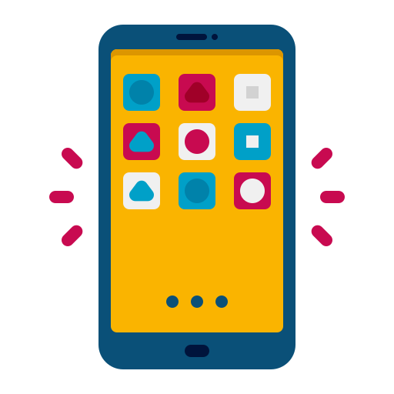
Code: Products
Websites
Web Apps
Mobile Apps

Slide 10

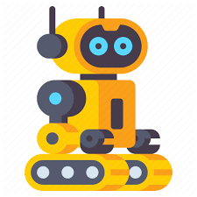

Code: Products
AI Models
Robotics
Games

Slide 11
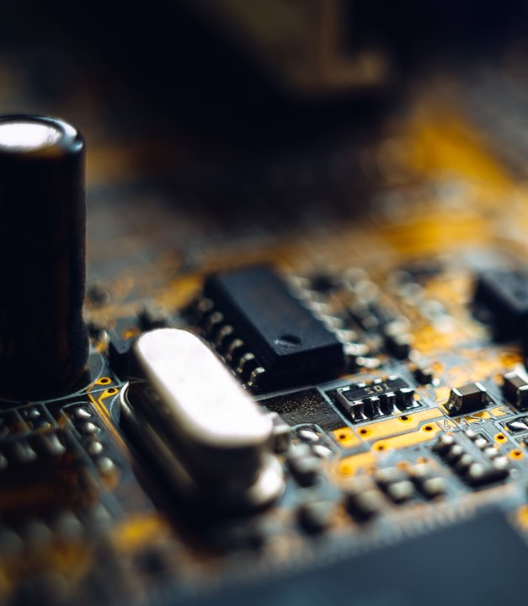
Summary
What we’ve learned so far
What is a Computer?
What is a Computer Program
Why study coding?
Where can we apply coding?
Why are products of coding

Slide 12
Thank you

